Slide 1


Exploring the impact of AI on Social Engineering attacks
AI for Cybersecurity Project
Team:
Aayushi Sinha - 21BCS120
Mourya Kakarapu - 21BCS049
Udayini Vedantham - 21BCS130
Nithish Chouti - 21BCS074
Notes:
Good afternoon sir,
This was the topic we selected for our project:
Exploring the impact of AI on Social Engineering Attacks

Slide 2

What is a Social Engineering attack?
Cybersecurity attacks where attackers use psychological tactics.
They use social skills to gather or compromise information about an organization or its systems by appearing trustworthy and legitimate.
Notes:
Okay so to give an introduction of what is a social engineering attack in the first place
It is a cybersecurity attack where attackers use psychological tactics and trick their victims into revealing confidential information about themselves which the attacker would later exploit and gain unauthorized access to their accounts for example

Slide 3

Common Social engineering attack types
Phishing
Spear phishing
Vishing and Smishing
Whaling
Pretexting
Baiting

Slide 4
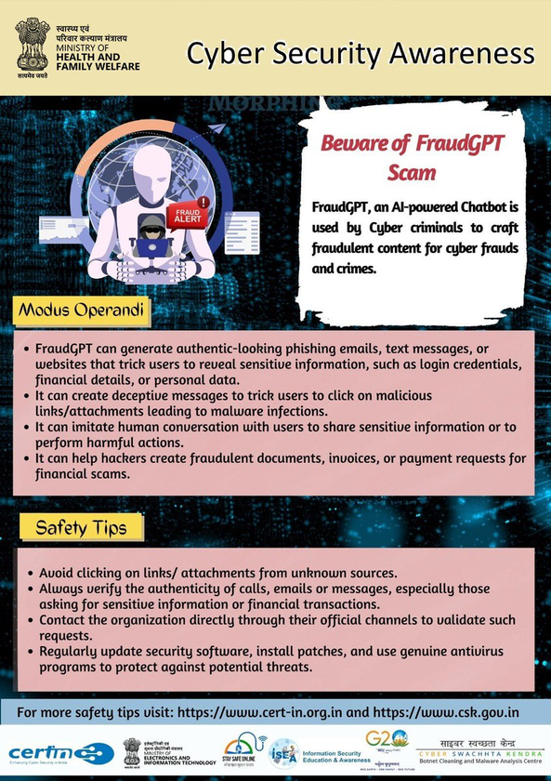
Role of AI in enhancing Social Engineering
The increasing use of Generative AI models has allowed attackers to create personalized and genuine phishing messages
“Models, [like] ChatGPT, FraudGPT, and WormGPT, have augmented existing threats and ushered in new dimensions of risk”
Researchers found that the entire phishing process can be automated using large language models, reducing the costs of phishing attacks by more than “95% while achieving equal or greater success rates”
Notes:
Social engineering - traditionally by humans, now with ai and nlp - automated and personalized. enabling them to impersonate legitimate entities, manipulate people through deepfake and extort sensitive information. A disturbing trend in cybercrime is the emergence of subscription-based models, such as "FraudGPT" and "WormGPT," which are designed specifically for malicious purposes. These models, available on the Dark Web, are tailored for social engineering attacks and make sophisticated AI-driven tactics available to virtually anyone with malicious intent

Slide 5
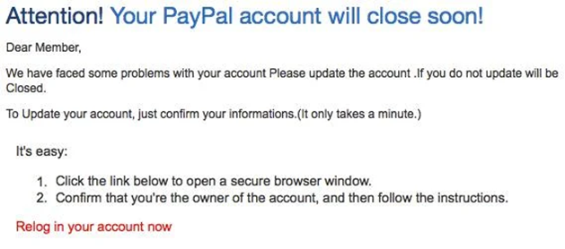
Traditional vs AI-powered phishing attacks
Traditional phishing attacks often contain many spelling mistakes, grammar issues and awkward phrasings, making them easier to categorize as illegitimate.
The mail has many spelling and grammatical errors like “Relog” instead of “LogIn”. It creates a sense of urgency for the user, including a threat

Slide 6
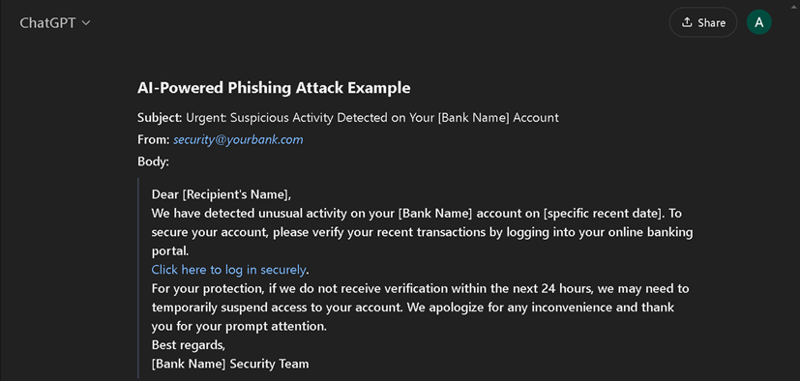
Traditional vs AI-powered phishing attacks
Using AI, these errors are highly minimized to the extent that the messages appear legitimate and accurate enough to win the user's trust.
Example of phishing email crafted using OpenAI’s ChatGPT-3, prompted by us
Notes:
As attackers are arming themselves up with AI based tools, we need to develop sophisticated AI/ML models as well to detect their attacks and protects users from these evolving threats? The first step is identifying and analyzing behavioral patterns used such phishing attacks.

Slide 7
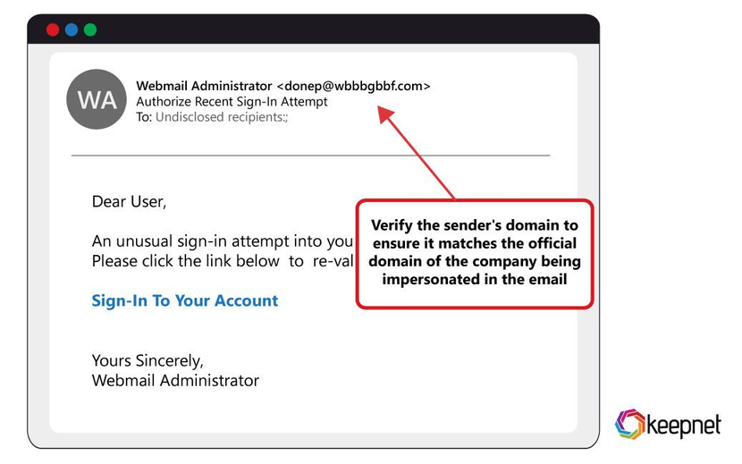
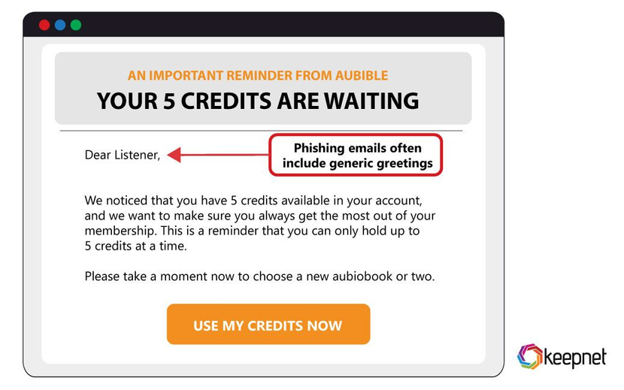
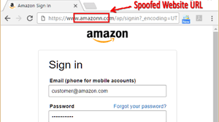
Identifying behavioral patterns used in social engineering attacks
According to the Cybersecurity and Infrastructure Security Agency (CISA), here are 6 common indicators of social engineering attacks and ways to recognize them:
Suspicious sender’s address
Generic greetings and signature
Spoofed hyperlinks and websites
Imitation of legitimate business addresses with altered characters or missing parts.
“Dear Valued Customer” instead of personal greetings. Lack of contact details in signature.
Hovering over links shows mismatched URLs or slight variations in domain names (e.g., .net instead of .gov).

Slide 8
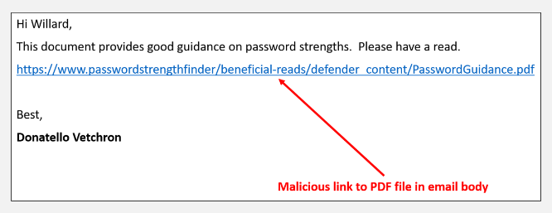
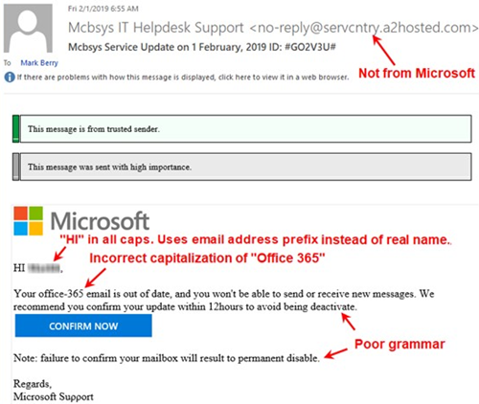
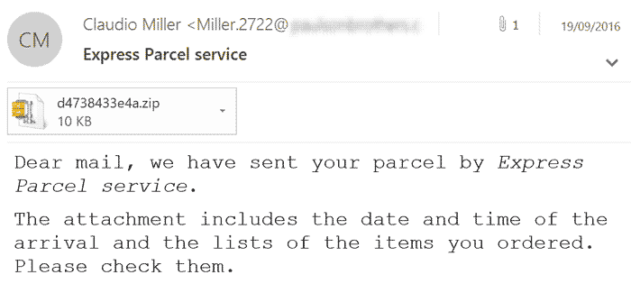
Identifying behavioral patterns used in social engineering attacks
According to the Cybersecurity and Infrastructure Security Agency (CISA), here are 6 common indicators of social engineering attacks and ways to recognize them:
Secondary Destinations
Spelling and layout
Suspicious attachments
Links in documents directing users to malicious sites, often hidden within legitimate-looking content.
Poor grammar, misspellings, and inconsistent formatting — signs of an unprofessional email.
Unsolicited attachments requesting urgent actions, often used to deliver malware or steal credentials.

Slide 9
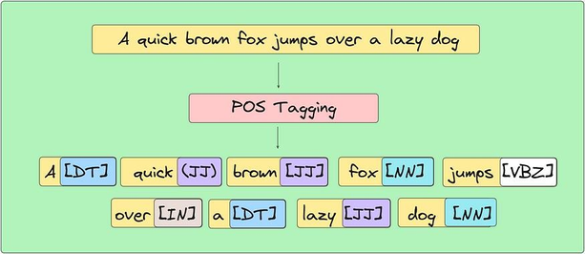
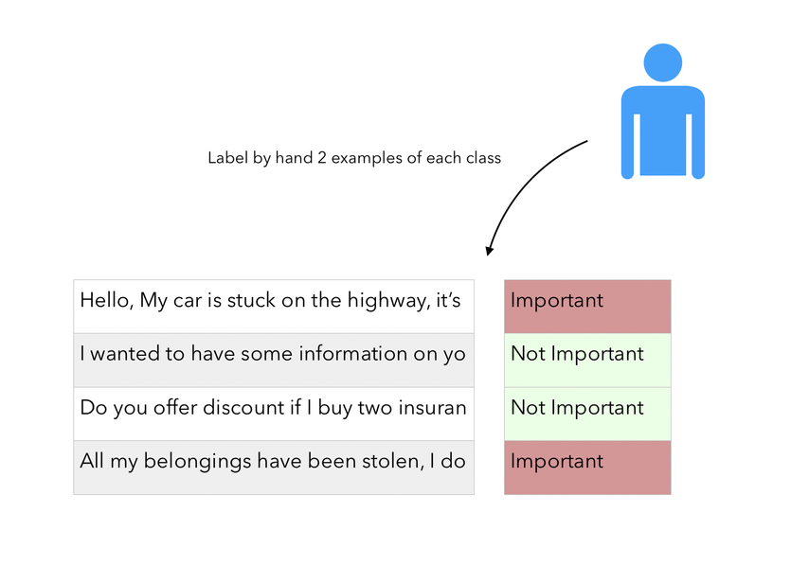
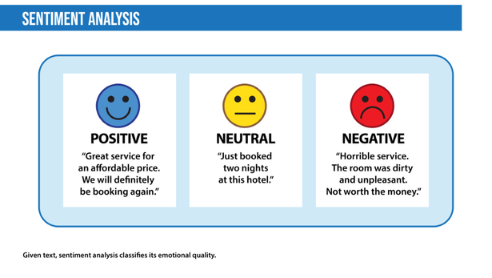
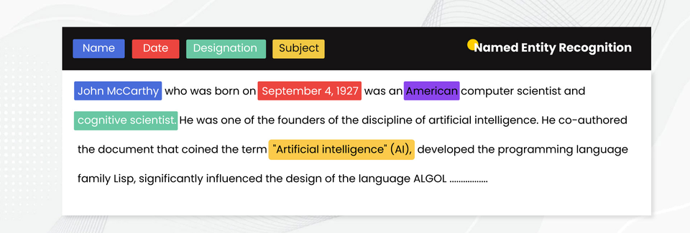
NLP Techniques for Detecting Social Engineering Attacks
Text classification
Named entity recognition (NER)
Part-of-speech tagging
Sentiment analysis

Slide 10

01
Text Classification for Phishing Detection
02
URL Phishing Detection
AI/ML and NLP Based Solutions
03
Real-time Suspicious Activity Monitoring and Anomaly Detection
04
Human-Machine Interaction Monitoring (Chatbots and Automated Responses)

Slide 11
Demonstration

Slide 12
THANK YOU!

